Slide 1
Digital Image
Raju Shrestha
Roll No. 48/2079
July 31, 2024

Slide 2
Contents
Digital Image
Sensor
Imaging by Scanning Technique
Hyper-Spectral Imaging

Slide 3
Digital Image
Digital image is a representation of an image as a matrix of numerical values.
Representation of a 2D image using binary values (0s and 1s).
Composed of pixels arranged in a rectangular grid.
Each pixel represents the color or intensity at a specific point in the image.
Digital images can be created through various means, including digital photography, scanning, and computer graphics.

Slide 4
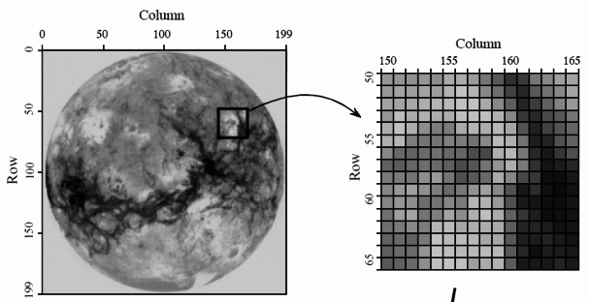
Digital Image

Slide 5
Digital Image
Components: Pixels, resolution, color depth.
Pixel: Smallest unit of a digital image, represents color/intensity.
Resolution: Number of pixels in an image (e.g., 1920x1080).
Color Depth: Number of bits per pixel, determines the number of colors (e.g., 24-bit).
File Formats: JPEG, PNG, TIFF, BMP.

Slide 6
Sensor
Device that detects and measures physical properties and converts them into signals.
Sensors are used to capture light and convert it into electrical signals.
Types:
Charge-Coupled Device (CCD)
Complementary Metal-Oxide-Semiconductor (COMS)

Slide 7
Sensor: CCD vs. CMOS
CCD Sensors: High-quality image capture, high sensitivity to light.
CMOS Sensors: Lower power consumption, faster readout speeds.
Applications:
Digital cameras
Smartphones
Scanners.

Slide 8
Imaging by Scanning Technique
Capture images by moving a sensor or the object relative to each other.
Applications:
Flatbed scanning: Used in document and image scanners.
Confocal microscopy: High-resolution images in biological research.
Remote sensing: Satellite and aerial imaging.

Slide 9
Hyper-Spectral Imaging
Captures and process information across the electromagnetic spectrum.
This does not just measure each pixel in the image, but also measure reflection, emission and absorption of electronic radiation.
Applications:
Remote Sensing: Analyzing vegetation, minerals, land use.
Medical Imaging: Identifying tissues, diseases.
Food Quality Control: Inspecting and sorting food products.

Slide 10
Hyper-Spectral Imaging
Advantages:
Detailed Information: Provides more data than traditional imaging.
Precision: Identifies materials and conditions that are not visible in RGB imaging.
Disadvantages:
Cost and complexity.
Fast computer, sensitive to detectors and large data storage capacities are needed for analyzing hyper-spectral data.

Slide 11
References
https://www.specim.com/technology/what-is-hyperspectral-imaging/
https://www.dspguide.com/ch23/1.htm

Slide 12
Thank You

